Slide 1
Good game
Cs52 Final project pitch, Spring 2018 JUNFEI YU

Slide 2
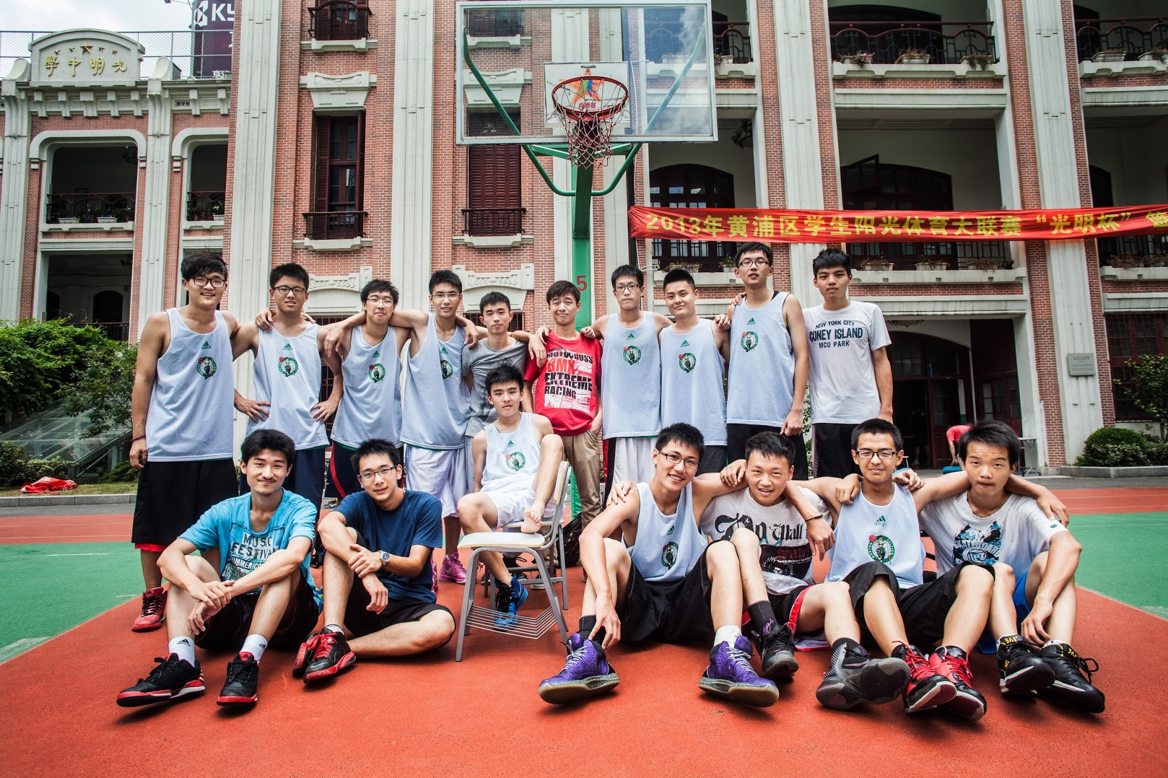
IT WAS GREAT

Slide 3
Game like that?
Notes:
When it is a game like that, there was no fun.
People don’t talk to each other after the game.

Slide 4
wHAT CAN WE DO?

Slide 5
Good game
CONNECT PEOPLE WHO LOVES TO PLAY BASKETBALL AT dartmouth college.
find available courts
find who they are willing to play with
know the average level of a game before they come
Social
Notes:
AN APP THAT CONNECTS PEOPLE WHO LOVES TO PLAY BASKETBALL AT dartmouth college.
People could find available courts and find who they are willing to play with.
People could know the average level of a game before they come.
Social

Slide 6
goal
“Make every game, a good game”
Notes:
We want to:
-Gamify our pickup games.
-Ensure the game will very likely to be a good game.
-Make friends. Stay connected!

Slide 7
Minimal Functional Specs
Review systems
Group message set up
Pre-game calculation
pOST-GAME EValuation
Ranking systems
Notes:
Minimal Functional Specs
1.Group message set up:
People could set up a message to invite people to play at a certain time in gym.
2.REVIEW SYSTEMS:
People could review other people’s scores who is in the group.
3.PRE-GAME CALCULATION:
People could see the average competition level for each game.
4.POST-GAME EVALUATION:
COULD EVALUATION OTHER PEOPLE IN A GAME. YOU ONLY GET YOUR FEEDBACK IF BOTH OF YOU HAVE EVALUATED EACH OTHER.
5.RANGKING SYSTEM:
SEE THE TOP 10 PLAYER IN THE LEAGUE RIGHT NOW
.

Slide 8
vision
Market size
Scalability
Notes:
Market size:
How many students at Dartmouth plays sports?
How many people at college in US?
This can literally be the good game for every single sports, basketball, soccer, tennis, pong at basement…

Slide 9
Thank you FROM GOOD GAME
Notes:
I am Junfei, again. This APP is called good game. Please join me!

